Slide 1
Trade Policy
Hamid Gilani

Slide 2
Summary of Previous Classes
Ideology through which system emanates, and we organize the society
Secular-liberal philosophy developed where man was sovereign
Capitalism was economic system that developed on the principle of freedom of choice
Law or legal theory is required to enforce the system on the society.
Current global economy is a result of international order formed after World War 2

Slide 3
Summary of Previous Classes
Historical Background of Bretton woods
US dollar backed by Gold
Other Currencies Pegged to Dollars
IMF acted as lender of the last resort
Participants in the Global Economy
Central Banks
Governments /Multilateral Institutions
Private Money Movers
Multinational Companies
Commodity Traders

Slide 4
Overview
We will discuss in coming weeks
Core principles of Trade theory
Participants and their role in Trading
Trade Agreements
Industrial Policy vs Free Trade debate
Trade Finance
International Business
How mercantilism is becoming relevant again
Economic Statecraft

Slide 5
Introduction to Trade Theory
Why do nations trade?
Gains from specialization and exchange
Core Question: What determines trade patterns

Slide 6
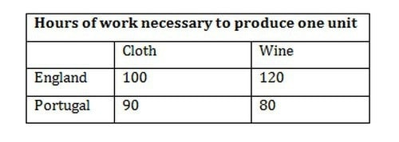
Comparative Advantage Model
Comparative advantage refers to a country’s ability to produce a good at a lower opportunity cost than another country.
Relevant cost producing a product is not in terms of labor units but rather its opportunity cost in terms of other goods

Slide 7
Heckscher-Ohlin Model
Countries export goods using abundant factor that is factors they are endowed with (capital vs labor)
Trade tend to equalize wages and return to capital
Leontief Paradox – US exports were labor intensive despite capital abundance in in 1950s and 60s

Slide 8
New Trade Theories
New trade theories developed as extending and relaxing assumptions
These theories introduced two main expect
Increasing returns to scale
Monopolistic competition
New Economic Geography
Emergence of industry clusters in certain areas
Examines technology dissemination
Transportation costs

Slide 9
Modern Perspectives
Firm Level Theories – Heterogeneous Firms
Global Value Chains – Production spread across multiple countries.
Institutions and Policy- Trade Agreements, WTO, and role of institutions

Slide 10
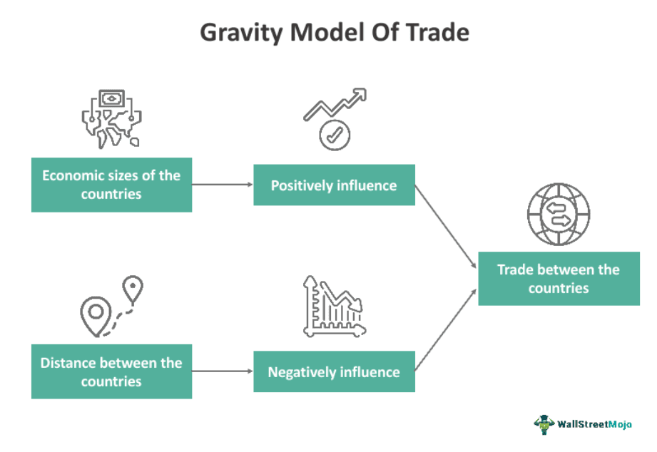
Gravity Model in Trade

